Slide 1

Final Project Identification of Aircraft
Aliweh, Khalid
CSCI E-89 Deep Learning
Harvard University Extension School
Prof. Zoran B. Djordjević

Slide 2
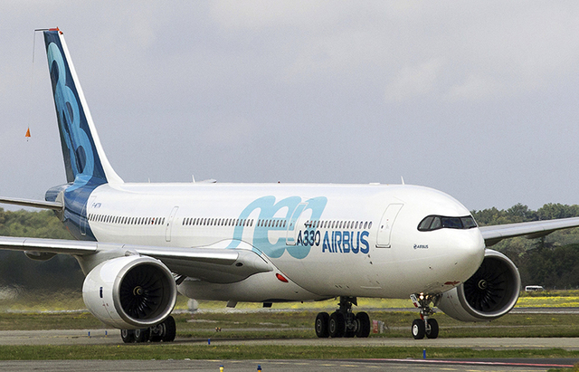
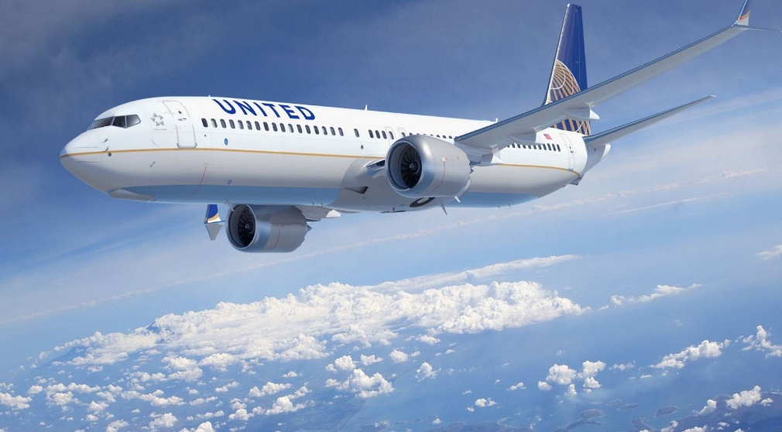
Problem Statement
The ability to identify a aircraft manufacturer given the aircraft image.
The solution provides a neural network model that classifies between various models of two major aircraft manufacturers, Airbus and Boeing
Airbus A330 Boeing 737
Images retrieved from: https://www.ainonline.com/aviation-news/air-transport/2016-11-16/united-pushes-back-boeing-737-orders-and-opts-max and https://www.seattletimes.com/business/boeing-aerospace/american-airlines-ends-talks-with-airbus-in-likely-victory-for-boeing-787/

Slide 3
Dataset
The dataset used in this demo is retrieved from the Fine-Grained Visual Classification of Aircraft (FGVC-Aircraft) project dataset.
Project URL: http://www.robots.ox.ac.uk/~vgg/data/fgvc-aircraft/
The dataset is available under the link: Data, annotation and Evaluation
Data size : 2.75 GB
The dataset contains 10000 images of aircrafts organized into four levels:
Model, e.g. Boeing 737-76J. Since certain models are nearly visually indistinguishable, this level is not used in the evaluation.
Variant, e.g. Boeing 737-700. A variant collapses all the models that are visually indistinguishable into one class. The dataset comprises 102 different variants.
Family, e.g. Boeing 737. The dataset comprises 70 different families.
Manufacturer, e.g. Boeing. The dataset comprises 41 different manufacturers.

Slide 4
Technologies & Techniques
Sequential convolutional neural network model (CNN) for the image classification consisting of 4 layers of conv_2d blocks.
Image data generators and image augmentation functionality to generate the training data.
Software libraries:
Python v(3.6.4)
Tensorflow v(1.5.0)
Keras v(2.1.4)
Layers
Models
Optimizers
Preprocessing
Numpy
Pandas
Matplotlib
Sklearn preprocessing
Pillow
Hardware Specs:
[name: "/device:CPU:0" device_type: "CPU" memory_limit: 268435456 locality { } incarnation: 12492784690254626557,
name: "/device:GPU:0" device_type: "GPU" memory_limit: 1318152600 locality { bus_id: 1 } incarnation: 12697062088792510139 physical_device_desc: "device: 0, name: GeForce GTX 965M, pci bus id: 0000:01:00.0, compute capability: 5.2"]

Slide 5
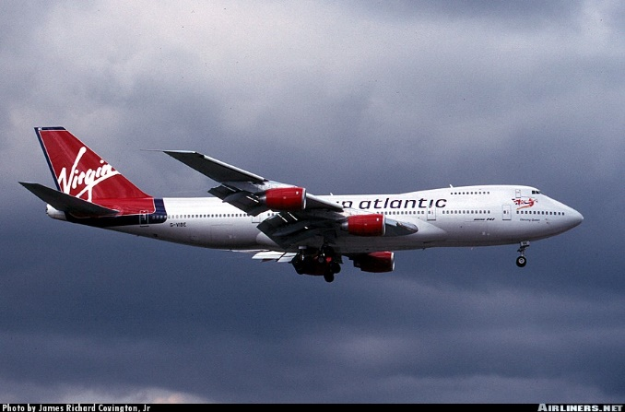
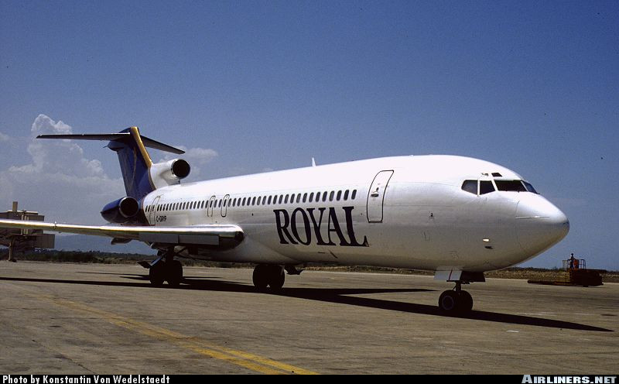
Data Preprocessing
Steps:
Extracting the data locally
Inspecting a random sample of the images
The images have different dimensions, sizes and there is a 12 px banner at the bottom of every image

Slide 6
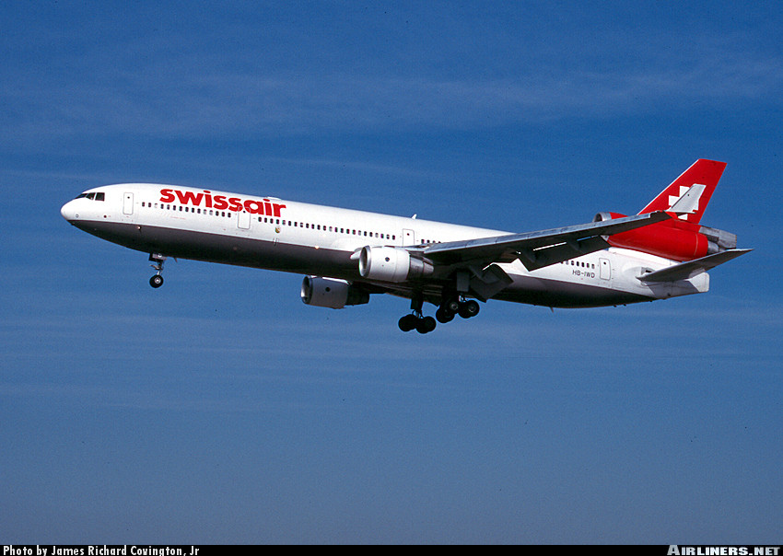
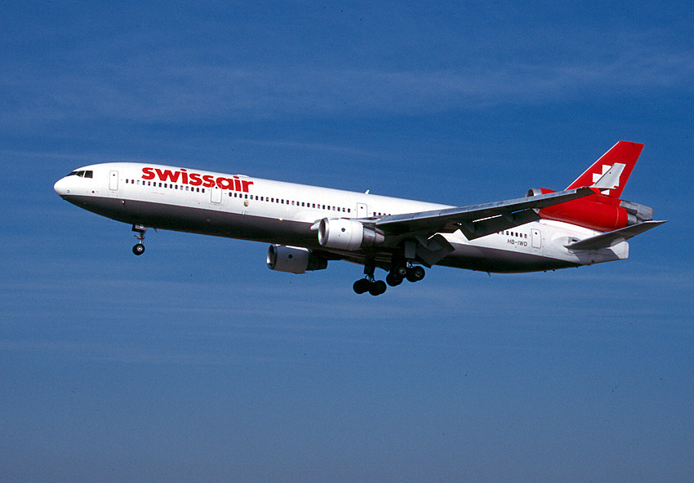
Data Preprocessing
Cropping the image banners:
Used Pillow to crop the bottom 12 px of all the pages and resaved all the clean images back to desk
Original Image with banner Cropped Image

Slide 7
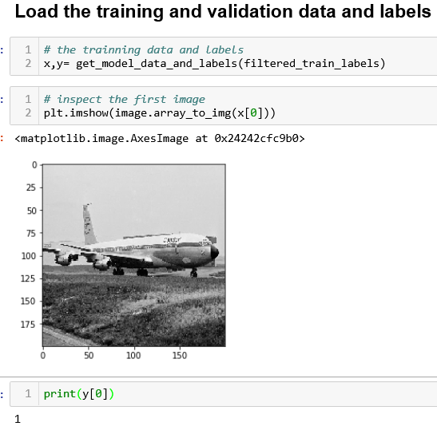
Data Preprocessing
Defined functions to extract specific classes from the test, validation, and training dataset files
Defined Functions to encode the labels and the reads the image data and resize it for a given label.
 | label_text
0 | 1025794 Boeing
1 | 1340192 Boeing
2 | 0056978 Boeing
3 | 0698580 Boeing
4 | 0450014 Boeing
5 | 1042824 Boeing
6 | 0894380 Boeing
7 | 1427680 Boeing
8 | 0817494 Boeing
9 | 0716386 Boeing

Slide 8
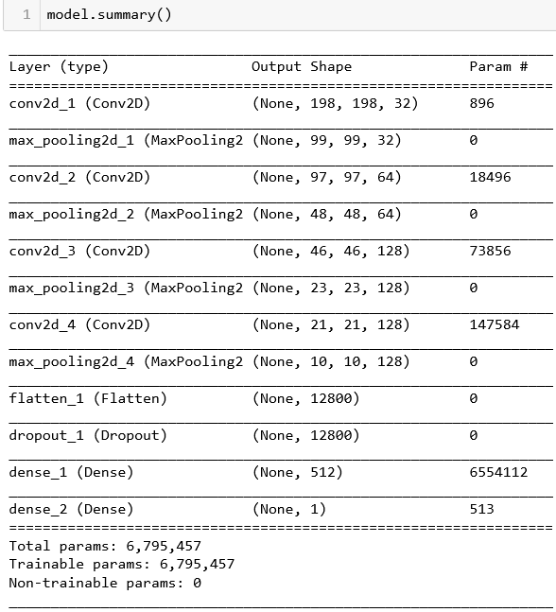
Building the model
The model consist of 4 conv2d layers, 4 max-pooling layers , flatten layer, a dropout layer and two dense layers.

Slide 9
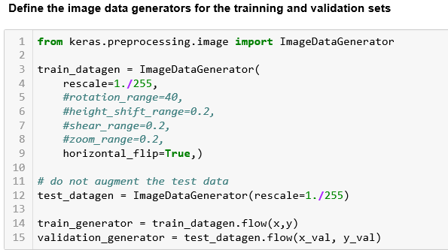
Data Generators and Augmentation
Defined the data generators and augmentation, for the initial run, only flip horizontal was enabled.

Slide 10
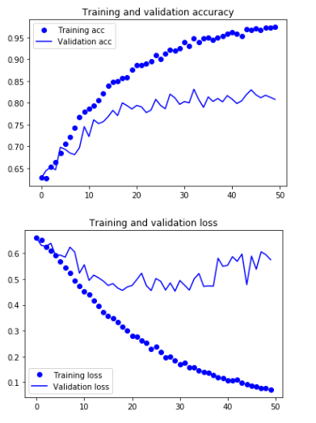
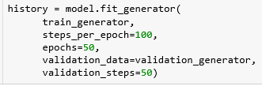
Training the Model for 50 epochs

Slide 11
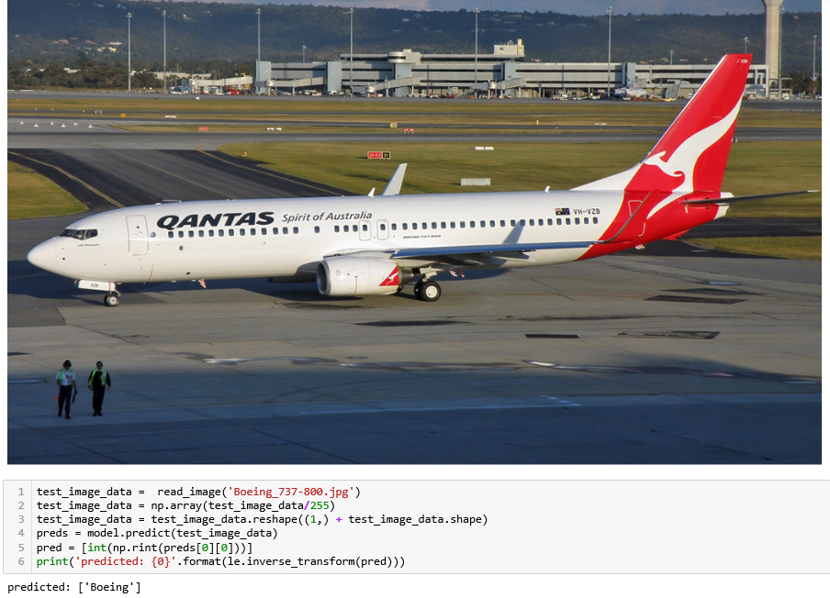
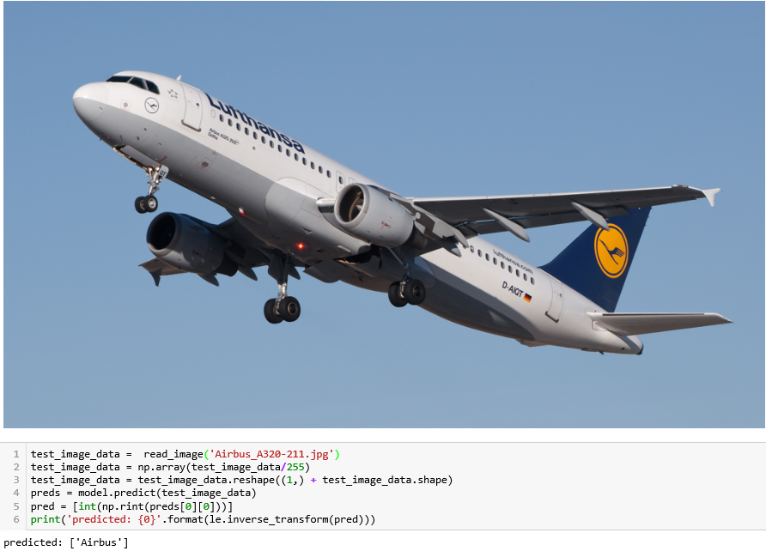
Testing the model results

Slide 12
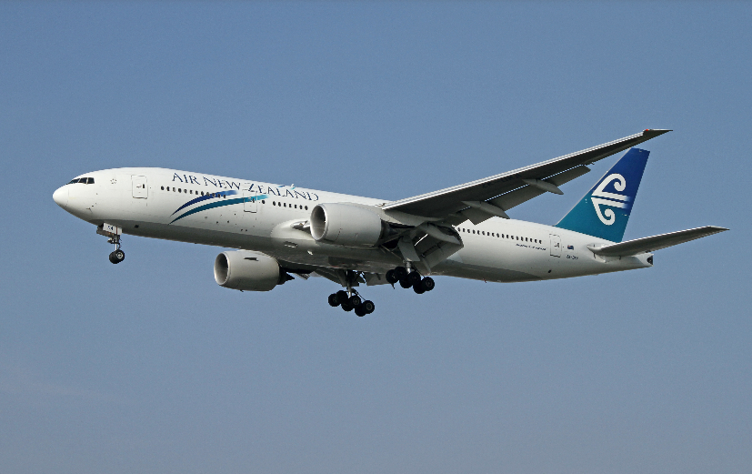
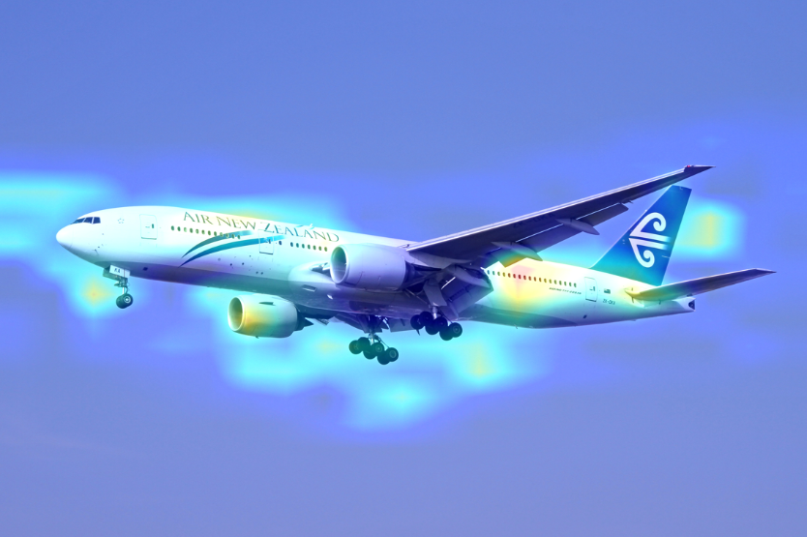
Visualizing the output
Boeing 777 model visualization heatmap

Slide 13
Challenges
Couldn’t increase the image array size more than 200*200 nor increase the first layer size to increase the accuracy due to hardware limitations.(I get OOM errors due to extra large array sizes).
Couldn’t create a large enough network that captures the variant to classify the aircraft model variant dataset due to the hardware limitations as well.

Slide 14
YouTube URLs, Last Page
Two minute (short): https://youtu.be/nMAg5-aPYaY
15 minutes (long): https://youtu.be/XIISTZKJPHg
Project GitHub URL: https://github.com/kaliweh/identificationofaircraft

